Slide 1

UniMate – AI University Assistant
AI-powered PDF Q&A with Gemini and FAISS
Manav Thakkar- 22AIML055
Ansh Trivedi – 22AIML056

Slide 2

The Problem
Time Wasted
Students spend hours manually searching through lengthy PDFs for specific information.
Limited Search
Traditional keyword-based search misses semantic context, leading to incomplete answers.

Slide 3
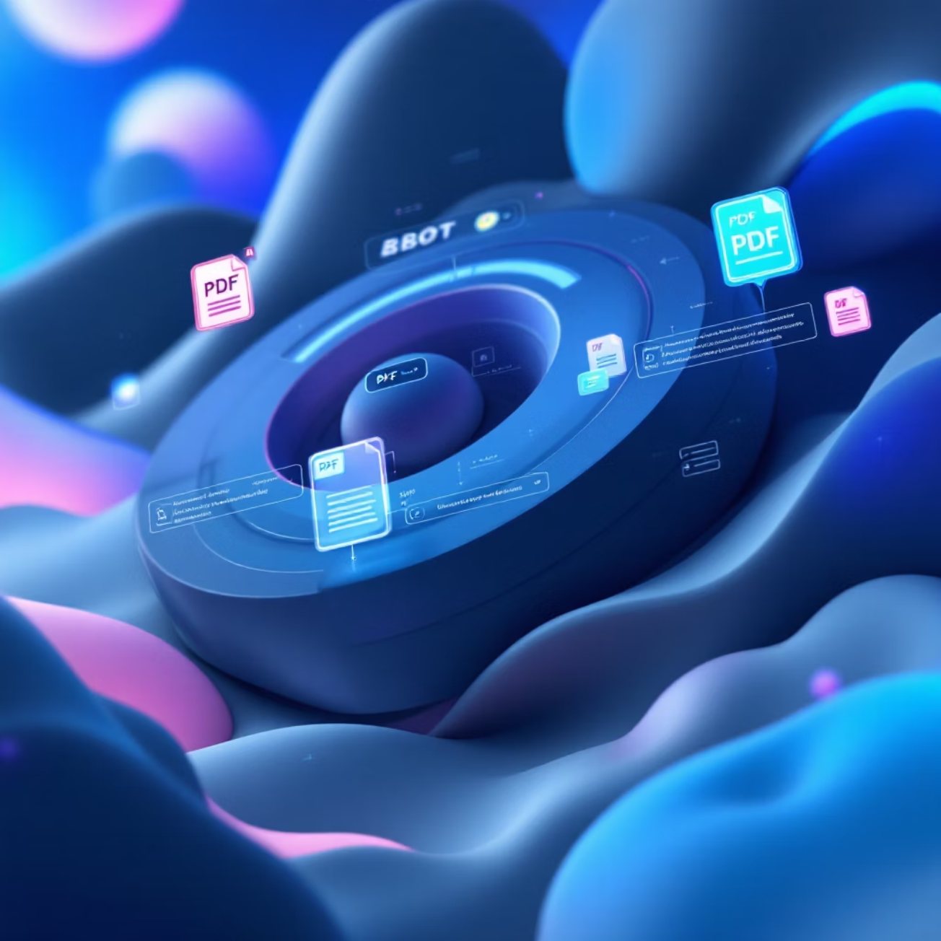

Our Solution: UniMate
Simple Process
01
02
Upload PDFs
Ask Questions
Drag and drop your documents
Natural language queries
03
Get Answers
Precise, well-formatted responses
Retrieval-Augmented Generation (RAG) ensures answers are grounded in your documents.

Slide 4




System Architecture
PDF Upload
Streamlit UI for document input
Text Processing
PyMuPDF extraction with paragraph-aware chunking
Hybrid Retrieval
FAISS + BM25 with cross-encoder re-ranking
Answer Generation
Gemini 2.5 Flash with page citations

Slide 5




Core Features
Multi-PDF Support
Hybrid Search
Upload multiple documents for unified search and retrieval across all files.
Combines semantic understanding with lexical matching for comprehensive results.
Smart Citations
Chat History
Answers include inline page references for easy verification and follow-up.
Persistent conversation history with topic management across sessions.

Slide 6

Tech Stack
Frontend/UI
Streamlit for clean, interactive interface
Backend Processing
Python, FAISS, BM25 for retrieval
AI Models
Google Gemini API for embeddings and generation
Storage: JSON for history, FAISS for vector store
PDF Parsing: PyMuPDF for text extraction

Slide 7
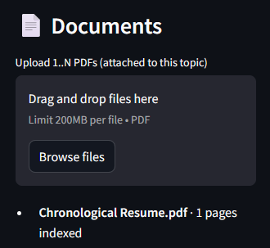
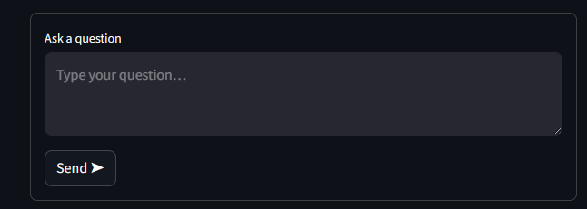
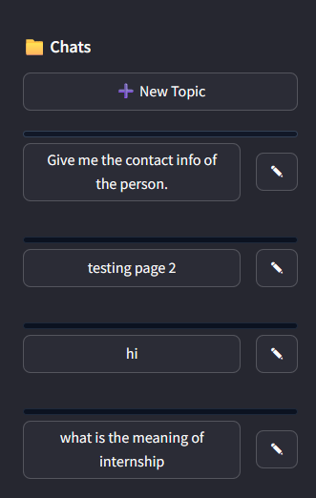
Demo Highlights
1
Document Upload
Upload PDFs → "Document Processed ✅"
2
Document Query
Ask specific question → Answer with page citations
3
General Query
"Who is PM of India?" → High-quality fallback answer
4
History Access
View previous Q&A organized by topics

Slide 8




Challenges Overcome
Hybrid Integration
Query Handling
Successfully combined FAISS and BM25 for improved retrieval accuracy.
Gracefully managing both document-based and general knowledge queries.
Persistent History
UI Design
Maintaining chat history and topics across user sessions.
Creating an intuitive, student-friendly interface for seamless interaction.

Slide 9
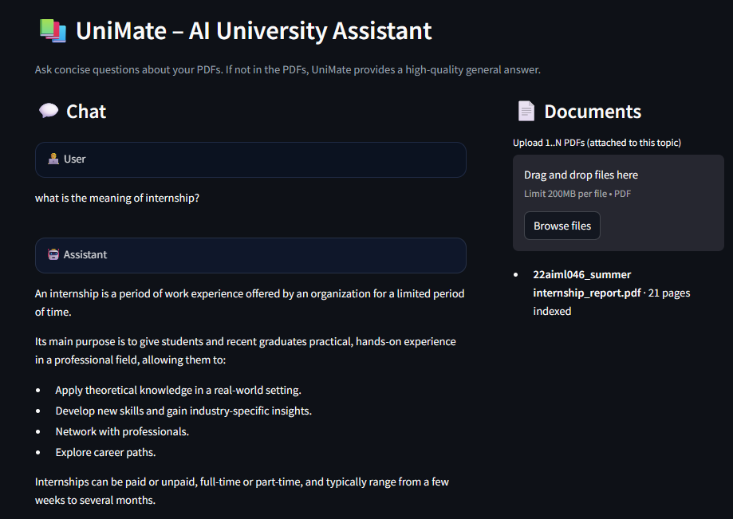
Results & Future Vision
Current Achievements
Fully functional student-friendly RAG application
Efficient hybrid retrieval system
Persistent chat history with topic management.
Production-ready modular architecture
Future Enhancements
Cloud deployment (Streamlit Cloud)
OCR support for scanned PDFs and images
Multi-language query capabilities
Personalized user dashboards

Slide 10


THANK YOU !
GitHub Repository
Access the complete source code and documentation:
UniMate-AI-University-Assistant.git

